Slide 1



KNITTING MANAGEMENT SOFTWARE
DIABETIC FOOT ULCER DETECTION USING DEEP
LEARNING APPROACHES
PRESENTED BY GUIDED BY
DATE:
Zeroth Review
1
Department of Computer Science & Engineering
PRESENTED BY
GUIDED BY
Sriram S S - 21CSR208
Vikash Narayanan M - 21CSR239
Poovarasan V - 21CSL267
Mr.N.Aravindhraj,
Assistant Professor/CSE

Slide 2
CONTEXT
Domain Knowledge
Problem Statement
Software Requirement Specification
IC01 Document Copy
Existing System
Modules Description
References

Slide 3
DOMAIN KNOWLEDGE
HTML, CSS, JavaScript: For building the user interface and frontend interactions.
Node.js: Backend server-side programming languages for handling business logic and data management.
MySQL, Mongo DB: Databases for storing and retrieving knitting-related data.
React.js: Frontend frameworks for creating dynamic and responsive user interfaces.
Bootstrap: CSS frameworks for styling and layout design.
Express.js: Backend frameworks for building web applications.
GitHub: Version control systems for collaborative development.

Slide 4
PROBLEM STATEMENT
Traditional methods of managing knitting processes are often manual, time-consuming, and prone to errors.
Lack of centralized data management leads to inefficiencies in tracking orders, inventory, and production schedules.
Difficulty in coordinating tasks among different departments such as design, production, and quality control.
Inability to provide real-time updates to customers regarding order status and delivery timelines.

Slide 5
SOFTWARE REQUIREMENT SPECIFICATION
FUNCTIONAL REQUIREMENTS:
User authentication and authorization for different roles (admin, manager, employee).
Customer management: Adding, editing, and deleting customer details.
Order management: Creating, updating, and tracking orders from placement to delivery.
Inventory management: Managing raw materials, stock levels, and supplier information.
Production management: Tracking knitting processes, assigning tasks, and monitoring progress.

Slide 6
SOFTWARE REQUIREMENT SPECIFICATION
NON FUNCTIONAL REQUIREMENTS:
User-friendly interface with intuitive navigation.
High performance and scalability to handle a large volume of data.
Security measures to protect sensitive information.
Compatibility with different devices and browsers.
Support for multi-language and multi-currency options.

Slide 7
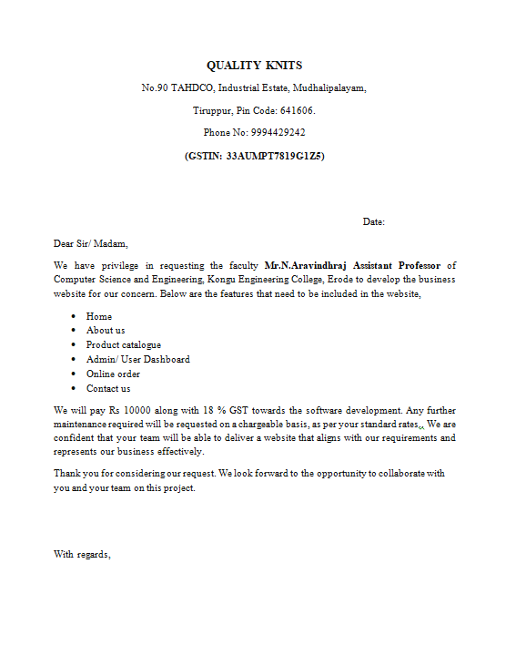
IC01 SUBMISSION

Slide 8
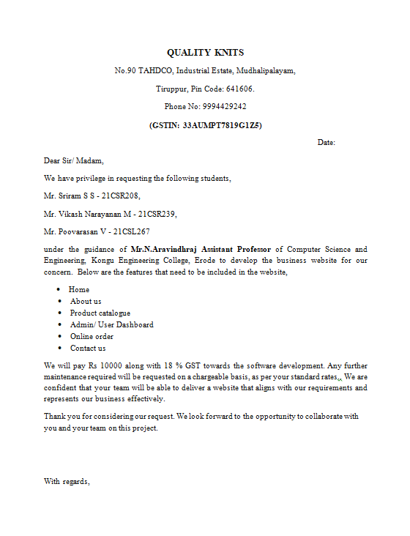
IC01 SUBMISSION

Slide 9
EXISTING SYSTEM
Manual methods such as paper-based records, spreadsheets, and standalone software applications.
Paper based records which is done by human can have errors.
Spread Sheets which are used will only have the ability to store the data in digital format and it can reduce the error only a little.
Standalone Software Applications lacks integration between different departments and Systems. It has limited visibility to real time data, leading to delays and inaccuracies in decision-making.

Slide 10
MODULES DESCRIPTION
User Authentication and Authorization: Allows users to register, login, and manage their accounts. Different roles such as admin, manager, and employee have varying levels of access permissions.
Customer Management: Enables adding, editing, and deleting customer details, including contact information and order history.
Order Management: Facilitates creating, updating, and tracking orders throughout the production cycle, from order placement to delivery.
Inventory Management: Manages raw materials, stock levels, and supplier information, ensuring adequate supplies for production.

Slide 11
MODULES DESCRIPTION
Production Management: Tracks knitting processes, assigns tasks to employees, and monitors progress to ensure timely completion of orders.
Employee Management: Tracks knitting employees work, their financial status and Salary allocation for Employees.
Reporting and Analytics: Generates reports on key metrics such as sales, production efficiency, and inventory turnover, providing insights for informed decision-making.

Slide 12
CONCLUSION
The Knitting Management System aims to streamline and automate the process of managing knitting operations.
By utilizing web technologies, we can create a centralized platform that enhances efficiency, accuracy, and collaboration among different stakeholders.
We believe that our solution will address the challenges faced by traditional knitting management systems and pave the way for improved productivity and customer satisfaction.

Slide 13
THANK YOU

